Slide 1








DK Music
Player
Let's sing and play!
01

Slide 2


Presented To: Mr. Kazi Hasnayeen Emad
(Lecturer)
Department of SWE
Green University of Bangladesh
Presented By: Dip Karmokar
(ID: 251034021)
Department of SWE
Green University of Bangladesh
02

Slide 3

INTRODUCTION
The DK Music Player is engineered as a Command-Line Interface (CLI) based solution, prioritizing a lightweight, fast, and efficient approach to managing and playing your digital music collection. Unlike many contemporary GUI-based players that can be resource-intensive and cluttered with unnecessary features, DK Music Player offers a streamlined experience directly from your terminal.
Let’s start!
03

Slide 4
Key Features and Functionality
Add Songs to Queue.
Playlist Management (Queue - FIFO)
Playback History (Stack - LIFO)
Pause & Resume
View Queue & History
04

Slide 5
TOOLS USED
Python 3
Pygame
VS Code
Threading
05

Slide 6

WHY PYTHON?
Readability and Simplicity
Powerful Built-in Modules & Rapid Development
06

Slide 7
objective
To design a simple and interactive music player using Python that supports essential functions like play, pause, resume, and exit.
To manage songs efficiently through a queue and history system for tracking upcoming and previously played tracks.
To provide a user-friendly experience with a lightweight, command-based interface and non-blocking playback using multithreading.
07

Slide 8
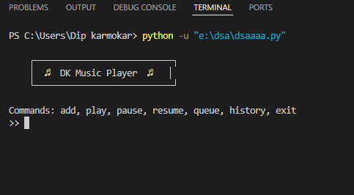
system implementation
08

Slide 9
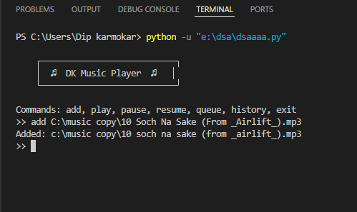
09

Slide 10
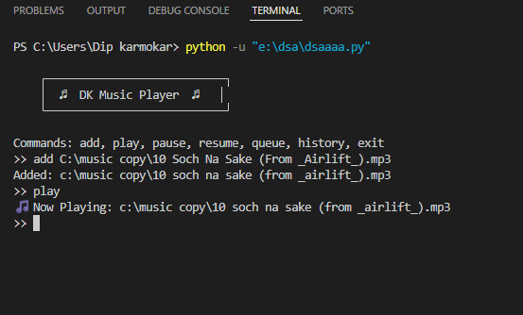
10

Slide 11
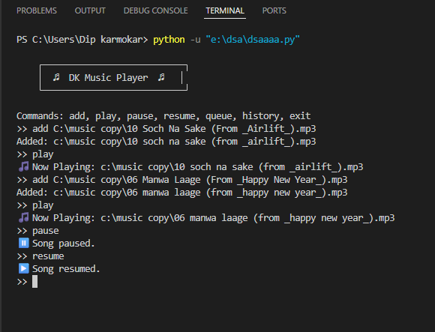
11

Slide 12
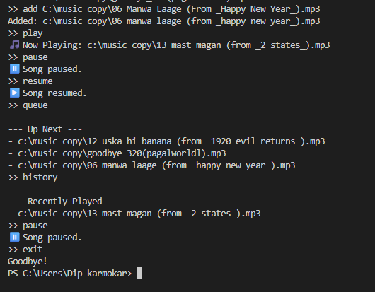
12

Slide 13
conclusion
The project demonstrates how fundamental data structures like Queue (for upcoming songs) and Stack (for recently played history) can be applied in real-world applications. By combining these with multithreading and simple commands, the system offers an efficient and user-friendly music experience. Overall, the project “DK Music Player” achieves its goal of being a lightweight and interactive music player built in Python.
13

Slide 14
THANK YOU !
14

